Slide 1
Interest and Dividend Income
Pub 4012 – Tab D
Pub 4491 – Lesson 9
Notes:
New in scope for 2019: Boxes 10-14 Market Discount and Bond Premium

Slide 2
Lesson Topics
Interest Income
US Savings Bonds and Treasury Obligation Interest
Tax exempt interest
Market discount
Bond premium
Interest in a foreign account
Early withdrawal penalty
Dividend Income
Ordinary dividends
Qualified dividends
Capital Gain dividends
Non-dividend distribution
Dividend reinvestments

Slide 3
Interest Income
Forms 1099-INT and 1099-OID

Slide 4
Interest Income
Interest income accrues on
Bank and credit union deposits
Bonds
Corporate or government
Loans
Is Interest earned or unearned income?
Review Tab I-1 in Pub 4012

Slide 5
Interest Income
Interest received from institutions reported on
Form 1099-INT
Form 1099-OID
Report as regular interest
Out of scope if requires OID adjustment
Brokerage Statement (substitute Form 1099-INT)
Schedule K-1
Notes:
Credit unions may call their interest “dividends” – it is interest and reported as such

Slide 6
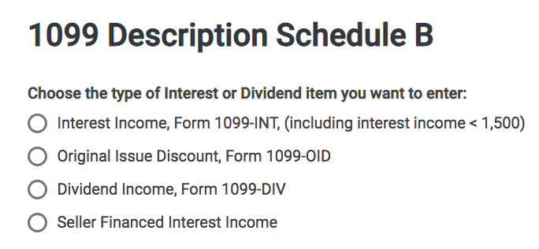
OID Interest Income
TaxSlayer Form 1099-OID entry section

Slide 7
Interest Income
No form issued if interest received from
Seller financed mortgage interest income – see comprehensive topics at end of this lesson
Private or foreign payer
Interest less than $10
All interest must be entered on return
Even if no reporting document received
Including tax-exempt interest

Slide 8
Interest Income
All interest taxable except
State or municipal obligations
Other state municipal bonds may be taxable to state of residence
U.S. obligations: T-Bills, Savings Bonds, etc.
Taxable on federal return
Exception: Certain EE or I bonds used for education expense – out of scope
Exempt on state return
Notes:
Informational:
Some treasury bonds may produce exempt interest for federal purposes
Certain “EE” or “I” bonds used for qualified education purposes
Requires Form 8815 – which is out of scope

Slide 9
Interest Income Early Withdrawal Penalty
Early withdrawal penalty adjustment
Penalty assessed on some interest account when funds withdrawn before maturity, such as a certificate of deposit
Penalty subtracted from AGI as adjustment to income
Penalty located in box 2 Form 1099-INT or box 3 on Form 1099-OID
Notes:
Early withdrawal penalty common with early withdrawal of CD

Slide 10
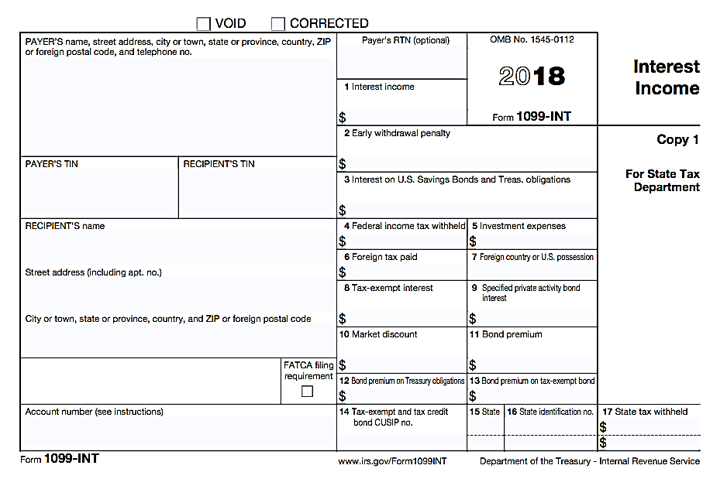
1099 – INT
New in scope
Boxes 10 –13
Notes:
New in scope for tax year 2019 boxes 10-13

Slide 11
Market Discount versus Bond Premium
Pub 550
Market discount bonds are bought at a discount
Paid less than face value
Bond premium is an additional amount paid over amount payable at maturity
Paid more than face value
Notes:
This slide deck contains very basic information regarding market discount and bond premium. More information is available in IRS pub 550. Returns requiring more than “key what you see” are out of scope.

Slide 12
Market Discount
Market discount occurs when value of bond decreases after issue date
Generally due to increase in interest rate
Taxpayer buys bond at a discount
Market discount is the difference between bond redemption price and taxpayer’s basis in bond at purchase
Notes:
This slide deck contains very basic information regarding market discount and bond premium. More information is available in IRS pub 550. Returns requiring more than “key what you see” are out of scope.
Market discount found on Form 1099-INT box 10

Slide 13
Market Discount (cont.)
Option to accrue market discount over period taxpayer owns the bond
Included as interest income
Reported on Form 1099-INT box 10
Key what you see
Calculating amount market discount is out of scope
TaxSlayer will include market discount amount as taxable interest on Schedule B
Notes:
This slide deck contains very basic information regarding market discount and bond premium. More information is available in IRS pub 550. Returns requiring more than “key what you see” are out of scope.

Slide 14
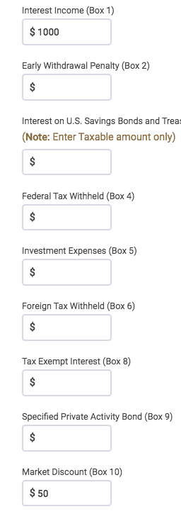
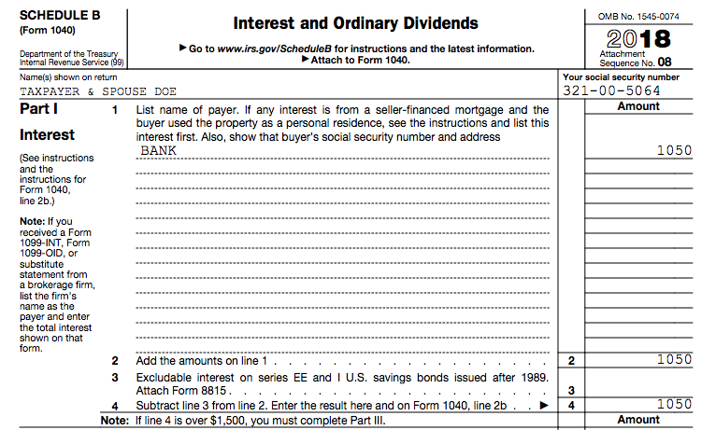
Market Discount (cont.)
Example: taxable interest $1,000
Market discount $50
$1,050 interest reported on Schedule B
Notes:
This slide deck contains very basic information regarding market discount and bond premium. More information is available in IRS pub 550. Returns requiring more than “key what you see” are out of scope.

Slide 15
Bond Premium
Bond premium is an additional amount paid over the total amount payable at maturity
Example: Taxpayer pays $1,050 for $1,000 bond = $50 bond premium
Bond premiums paid are part of bond’s basis
Bond basis in above example = $1,050
Notes:
This slide deck contains very basic information regarding market discount and bond premium. More information is available in IRS pub 550. Returns requiring more than “key what you see” are out of scope.

Slide 16
Bond Premium (cont.)
Option to amortize bond premium when bond yields taxable interest
Taxable interest reduced by bond premium
Basis of bond reduced by bond premium deducted
Must amortize bond premium when bond yields tax-exempt interest
Tax-exempt interest reduced by tax-exempt bond premium (not visible on Schedule B)
Basis of bond reduced by bond premium deducted
Notes:
This slide deck contains very basic information regarding market discount and bond premium. More information is available in IRS pub 550. Returns requiring more than “key what you see” are out of scope.

Slide 17
Bond Premium (cont.)
Form 1099-INT in scope bond premiums:
Box 11 Bond premium
Box 12 Bond premium on Treasury obligations
Box 13 Bond premium on tax-exempt bond
Key what you see
Calculating amount of amortized bond premium is out of scope
TaxSlayer will enter amount of bond premium as a negative number on Schedule B unless tax exempt
Notes:
This slide deck contains very basic information regarding market discount and bond premium. More information is available in IRS pub 550. Returns requiring more than “key what you see” are out of scope.

Slide 18
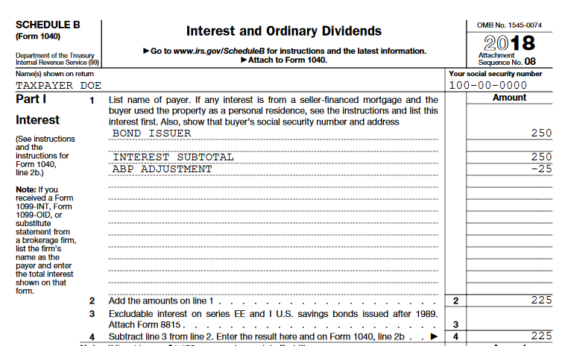
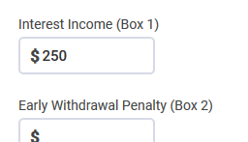
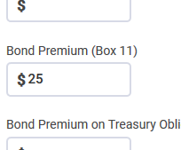
Bond Premium Example
c) Results in:
a) Interest Income
b) With (amortized) bond premium
Amortizing bond premium reduces interest income

Slide 19
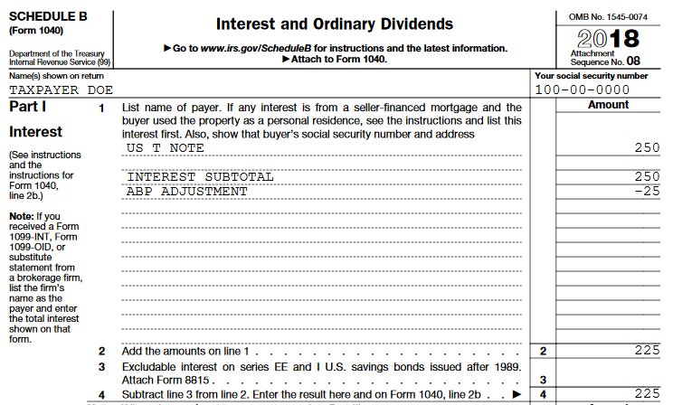
T-Note Premium Example
c) Results in:
a) Interest Income
b) With (amortized) bond premium
Amortizing bond premium reduces interest income

Slide 20
Tax-Exempt Premium Example
c) Results in:
a) Interest Income
Reduction in the amount of tax exempt interest:
$250 box 8
minus
$25 box 13 =
$225 total tax exempt interest entered on Form 1040 line 2a
TaxSlayer 2019 is not reducing box 8 by the amount in box 13 at this time.
A box 13 entry requires a manual reduction of tax exempt interest in box 8 by the amount in box 13.
b) With (amortized) bond premium
Exempt interest income does not show on Schedule B
Notes:
Verify TaxSlayer entry EVERY TIME in the event TaxSlayer updates and auto-reduces tax exempt interest by the amount in box 13

Slide 21
1099 – INT
Which boxes are out of scope?
Refer to Tax-Aide Scope Manual
Notes:
Instructor note: Have volunteers review the Tax-Aide Scope Manual. The answer is on the next slide.
Report 1099-OID box 1 interest as you report regular interest
FATCA stands for Foreign Account Tax Compliance Act.
Box 5 Investment expenses. It is no longer a Schedule A deduction under the TCJA.

Slide 22
1099 – INT Out-of-Scope
FATCA is out of scope
Notes:
Report 1099-OID box 1 interest as you report regular interest
FATCA stands for Foreign Account Tax Compliance Act.
Box 5 Investment expenses. It is no longer a Schedule A deduction under the TCJA.

Slide 23
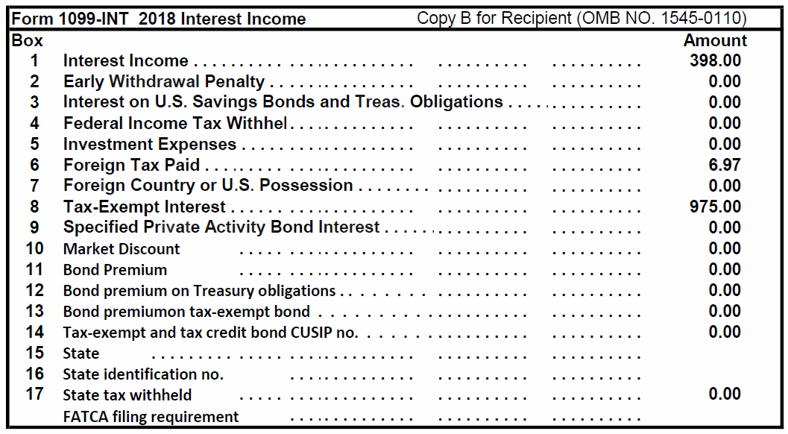
Interest Income – Sample Brokerage Statement
FATCA filing requirement out of scope
Notes:
Emphasize:
All the information as in 1099-INT boxes
FATCA is out of scope
Format varies by payer
Examine all pages carefully- check to make sure you have all pages. Should say 1 of 12, 2 of 12, etc.

Slide 24
Interview
Review Forms 1099-INT and 1099-OID for scope
FATCA filing requirement
Does the taxpayer receive interest on savings or checking accounts? (may be less than $10 so no tax form)
Notes:
Interest less than $10 taxable – report on return

Slide 25
Interest Income Quiz
Is the following interest taxable on a federal return?
New York City bond interest
Treasury bill interest
Ford Motor Co bond interest
Interest on loan to cousin Charlie
No
Yes
Yes
Yes

Slide 26
Dividend Income
Form 1099-DIV

Slide 27
Dividend Income
Dividend income reported on
Form 1099-DIV
Brokerage or mutual fund statements (substitute Form 1099-DIV)
Schedule K-1
Notes:
Emphasize
Many taxpayers have direct investments, not held in a brokerage account
Probing questions and extra care are needed to make sure all are accounted for

Slide 28
Dividend Income
Dividends are paid out of earnings and profits from corporations
Dividends paid to equity shareholders
“Total ordinary dividends” includes two subsets
Qualified dividends
199A dividends

Slide 29
Dividend Income
Ordinary dividends that are not qualified
Taxed at marginal tax rate
Qualified dividend subset
Qualify for lower capital gain tax rate
199A dividend subset
Qualify for qualified business income (QBI) deduction – see Standard Deduction lesson
May need to look at codes in “other” areas of Schedule K-1
E.g. Code I in box 14 of Schedule K-1 Form 1041
Notes:
Emphasize
Capital gains may be taxed at a lower rate than ordinary income
Rate can be as low as zero

Slide 30
Dividend Income
Capital gain dividends
Paid by mutual funds and Real Estate Investment Trusts (REITs)
Qualify for lower capital gain tax rate regardless of how long shares held
Sec. 1250 gains (box 2b)
A subset of box 2a total capital gain
In scope for Tax-Aide

Slide 31
Dividend Income
Out of scope
Section 1202 gain (box 2c)
28% gain (box 2d)
Liquidation distributions (boxes 9 and 10)

Slide 32
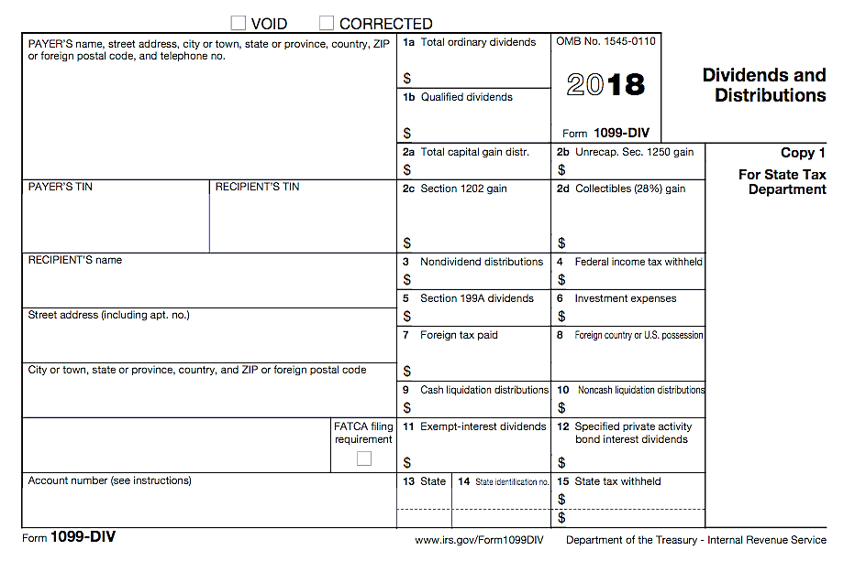
1099-DIV
Which boxes are out of scope?
Refer to Tax-Aide Scope Manual
Notes:
Instructor note: Have volunteers review the Tax-Aide Scope Manual. The answer is on the next slide.
Box 6 Investment expenses. It is no longer a Schedule A deduction under the TCJA.

Slide 33
1099-DIV Out-of-Scope
In scope:
Box 5 Section 199A dividends
OOS
OOS
OOS
OOS
FATCA Out of Scope
Notes:
FATCA stands for Foreign Account Tax Compliance Act.

Slide 34
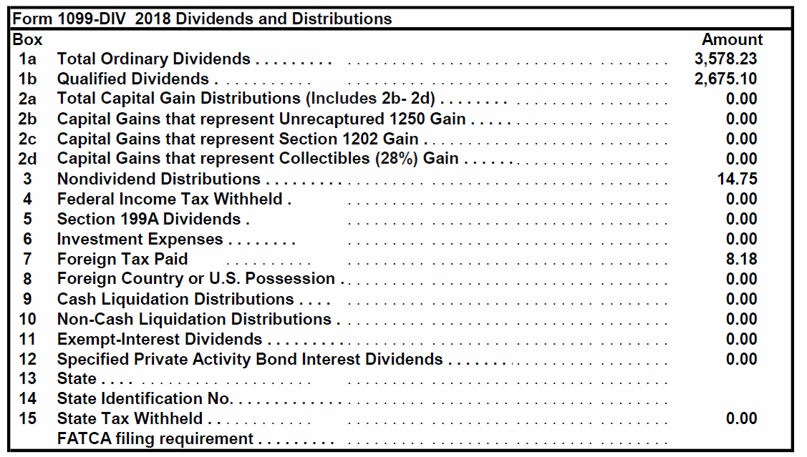
Form 1099-DIV Brokerage Statement
Lines 2c and 2d Out of Scope
Lines 9 and 10 Out of Scope
FATCA filing requirement
Out of Scope
Notes:
Emphasize
Same as boxes on 1099-DIV
Box 2c Sec 1202 gains – out of scope
Boxes 9 and 10 Liquidation distributions – out of scope
FATCA filing requirement - out of scope
Look out for state withholding

Slide 35
Dividend Income
Nondividend distributions
Nontaxable distribution
Postponed until stock sold
Return of capital
Basis reduced by nontaxable dividend amount
Covered security – payer keeps track of basis
Non-covered security – taxpayer must adjust basis of investment (broker/mutual fund usually tracks unofficially)
Notes:
Definition of “covered securities” generally
Stock purchased in 2011 and later
Mutual fund shares purchased in 2012 and later
Other securities (options, bonds, etc.) have later “covered” dates
TaxSlayer has a place to enter nondividend distribution, but doesn’t affect return

Slide 36
Dividend Income
Reinvested dividends are taxable
Dividends taxed and new shares purchased
Taxable amount becomes basis of new shares purchased
Payer or broker tracks basis as all new purchases are covered securities

Slide 37
Net Investment Income Tax
Net Investment Income Tax (NIIT) out of scope
3.8% net investment tax on lesser of net investment income or amount MAGI exceeds
$250,000 MFJ and QW
$200,000 S and HoH
$125,000 MFS
Notes:
In general, investment income includes, but is not limited to:
interest, dividends, capital gains
rental and royalty income
non-qualified annuities
income from businesses involved in trading of financial instruments or commodities (out of scope)
businesses that are passive activities to the taxpayer (out of scope)
The tax applies on the lesser of net investment income or the amount by which AGI exceeds the thresholds above

Slide 38
Interest or Dividend State Tax Withheld
To enter state tax withheld Form 1099-INT/DIV
Search “state withholding” and select
or
Go to Payments and Estimates Screen
Carries to Schedule A and State Returns
Can add more state withholding entries
Don’t duplicate state tax from W-2, 1099-R or 1099-G
Notes:
Class can find a “Note” at the bottom of Pub 4012 Interest Income (continued) page

Slide 39
Private Activity Bond Interest
Pub 4012 Tab D
When private activity bond (PAB) interest entered on Form 1099-INT/DIV
Can now be entered on the 1099-INT or -DIV entry screen
May generate alternative minimum tax (AMT)
If AMT applies, return is out of scope
Notes:
If any PAB entry, need to check AMT (1040 line 45) – IF >0 OUT OF SCOPE
Under Section 103(a) of the Internal Revenue Code (IRC), interest on private activity bonds is not excluded from gross income unless the bond is a qualified bond. Interest from private activity bonds became subject to the Alternative Minimum Tax (AMT) after the Tax Reform Act of 1986, with the exception of hospital and non-profit college bonds. All things equal, yields on private activity bonds are higher due to this tax treatment.
According to Section 141 of the IRC, a municipal bond will be deemed a private activity bond if more than 10% of the proceeds from the bond issue are used for any private business, and the principal and interest payment on more than 10% of the sale proceeds of the issue is secured by a private business property. Secondly, a municipal bond will be classified as a private activity bond if the amount of proceeds of the issue used to make loans to non-governmental borrowers exceeds 5 percent of the proceeds or $5 million, whichever is less.

Slide 40
Quality Review Interest and Dividend Income
Review Intake Booklet for interest or dividends
Verify all interest and dividend values are in scope
Verify interest or dividend income entered correctly
Including interest or dividend received without paperwork
Review for state adjustments

Slide 41
Quality Review Interest and Dividend Income
Compare to prior year
Missing accounts
Foreign tax credit or deduction
Review for any missing interest or dividends

Slide 42
Dividend Income Quiz
True or False?
Dividends reinvested in additional shares are not taxable
False – reinvested dividends are taxable
Dividends received from Credit Union accounts are entered in the dividend section in TaxSlayer
False – credit union dividends from savings and checking accounts are reported as interest
Notes:
Emphasize
Whether or not reported on a 1099, taxpayer must report all their income

Slide 43
Dividend Income Quiz
True or False?
Payers of dividends less than $10 don’t have to issue 1099
True – same rule as for interest payers
Taxpayers are not required to report dividends if they do not receive Form 1099-DIV
False – all income must be reported on the tax return
Notes:
Emphasize
Whether or not reported on a 1099, taxpayer must report all their income

Slide 44
Multiple Tax Forms – TIP
Some taxpayers will receive several forms from a single payer
Make it easier for your reviewer by adding some account info as the “Payer’s name”
Such as: “B of A 1234” (where 1234 are the last 4 digits of the Bank of America account number)

Slide 45
Comprehensive Topics
Interest and Dividends
Notes:
These topics are marked comprehensive because they are rarely encountered
All Counselors should be aware of the topics
Experienced Counselors should be well versed in these topics and how to look up guidance in Pub 4012
Seller financed mortgage interest
Foreign accounts

Slide 46
Seller-financed Mortgage Interest
Taxpayers receiving interest from seller-financed mortgage must report interest income
Return must include buyer’s name, address, and SSN
Find Seller Financed Mortgage Interest in Volunteer Resource Guide (Pub 4012) Tab D for TaxSlayer entries

Slide 47
Foreign Account or Foreign Trusts
Taxpayers with interest or signature authority in foreign bank accounts must disclose
Taxpayers with foreign trusts must disclose
Beneficiary, grantor or transferor
Does not matter whether current income or not – must report the account
Out of scope – Refer to professional preparer
Notes:
Schedule B Questions
Read questions carefully –
Check here if at any time during this tax year, you had an interest in or a signature or other authority over a financial account in a foreign country, such as a bank account, securities account, or other financial account.
Check here if you are required to file Form FinCEN 114 to report that financial interest or signature authority and select the name of the country below.
Check here if at any time during the tax year you received a distribution from, or were the grantor of, or transferor to, a foreign trust.

Slide 48
Foreign Accounts or Specified Financial Assets
Special Note
If any FATCA box is checked or if taxpayer has foreign accounts or financial assets $50,000 or more
Advise taxpayer of substantial penalties for not filing the required forms
Out of scope – Refer taxpayer to professional preparer
Notes:
See form 8938 instructions for the definition of a specified foreign financial asset – it is not limited to bank or brokerage accounts.

Slide 49
Interest and Dividend Income
Questions?
Comments?

